Slide 1



P209- Patient's Condition Classification Using Drug Reviews
Presented By: 1.Adarsh M
2. Nisarga P J 3. Nishant S K 4.Sachin B 5.Sowmya D R 6.Priyanka B G
7. Panuganti HariNagaPriya

Slide 2
Contents
Business Objective
Project Architecture
Data Collection & Details
Exploratory Data Analysis
Sentimental Analysis
Model Building
Model Evaluation
Deployment
Challenges Faced during Project

Slide 3
Business Objective:
Business Objective:
This is a sample dataset which consists of 161297 drug name, condition reviews and ratings from different patients and our goal is to examine how patients are feeling using the drugs their positive and negative experiences so that we can recommend him a suitable drug. By analyzing the reviews, we can understand the drug effectiveness and its side effects.
The dataset provides patient reviews on specific drugs along with related conditions and a 10 star patient rating reflecting overall patient satisfaction.
So in this dataset, we can see many patients conditions but we will focus only on the below, classify the below conditions from the patients reviews
a. Depression
c. High Blood Pressure
d. Diabetes, Type 2

Slide 4
Attribute Information:
1. DrugName (categorical): name of drug 2. condition (categorical): name of condition 3. review (text): patient review 4. rating (numerical): 10 star patient rating 5. date (date): date of review entry 6. usefulCount (numerical): number of users who found review useful

Slide 5






Project Architecture / Project Flow
Business
Understanding
Model Deployment
Data Collection
Model Evaluation
Exploratory Data Analysis
Data Preprocessing

Slide 6
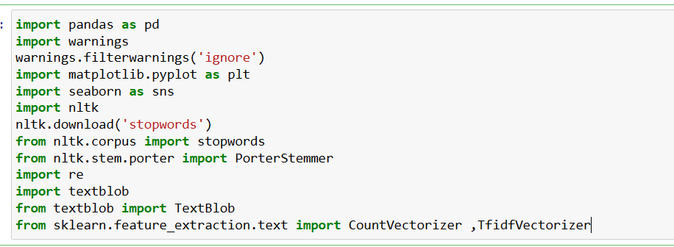
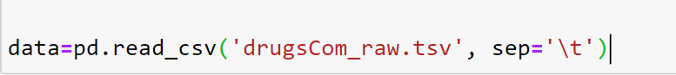
Importing libraries and data sets

Slide 7
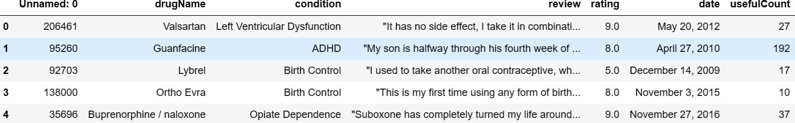
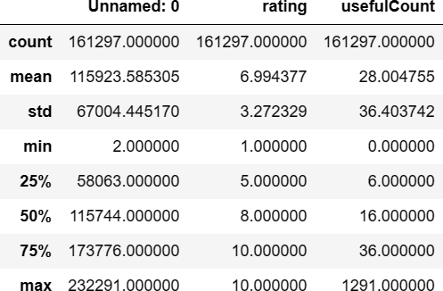
Data Collection & Details
161297 Rows and 7 Columns Attribute Information:
1. DrugName (categorical): name of drug
2. condition (categorical): name of condition
3. review (text): patient review
4. rating (numerical): 10 star patient rating
5. date (date): date of review entry
6. usefulCount (numerical): number of users who found review useful

Slide 8

Exploratory Data Analysis (EDA)

Slide 9
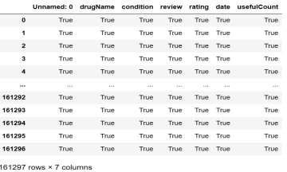
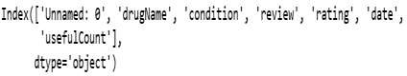
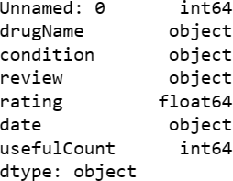
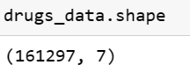
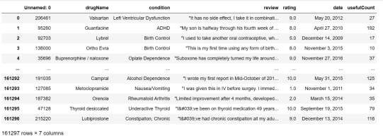
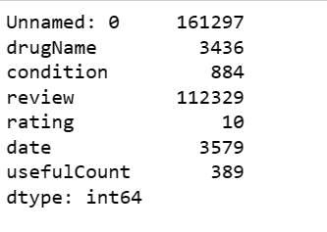
Exploratory Data Analysis (EDA)
Is Null present?
Data Type
Column
Shape
Correlation
Describe the data
Find the Unique values

Slide 10
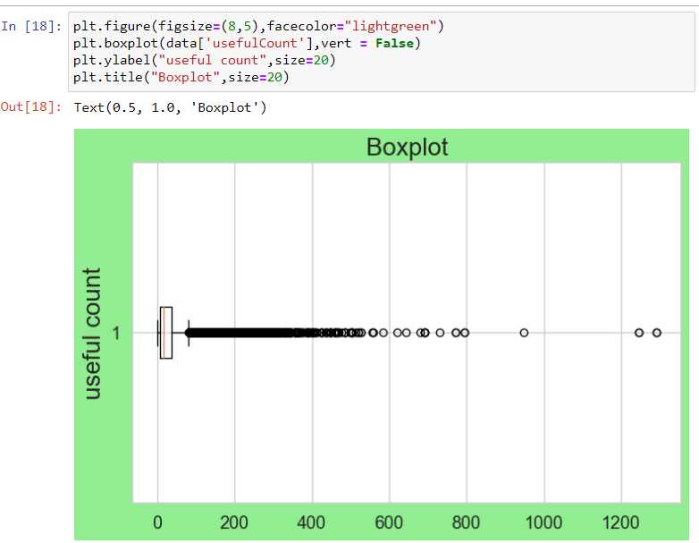
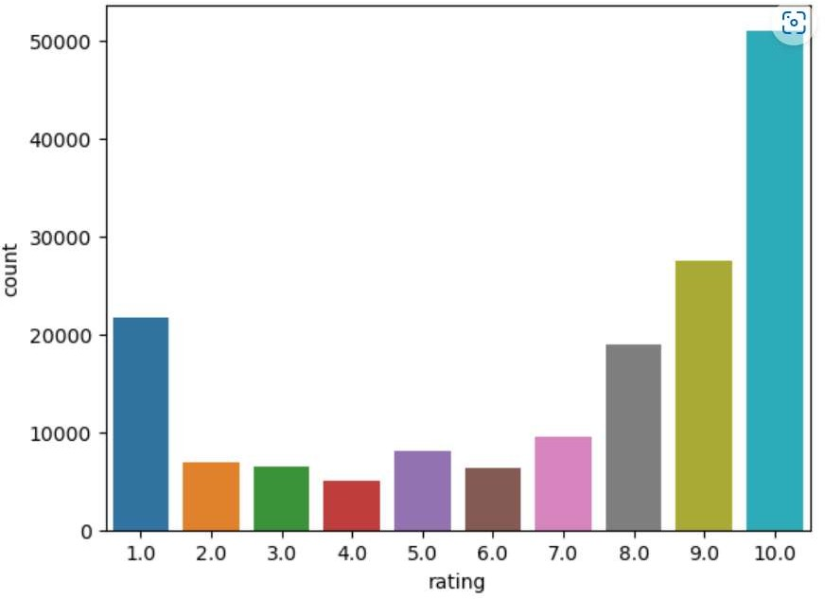
EDA Visualizations
Count Plot
Box Plot

Slide 11
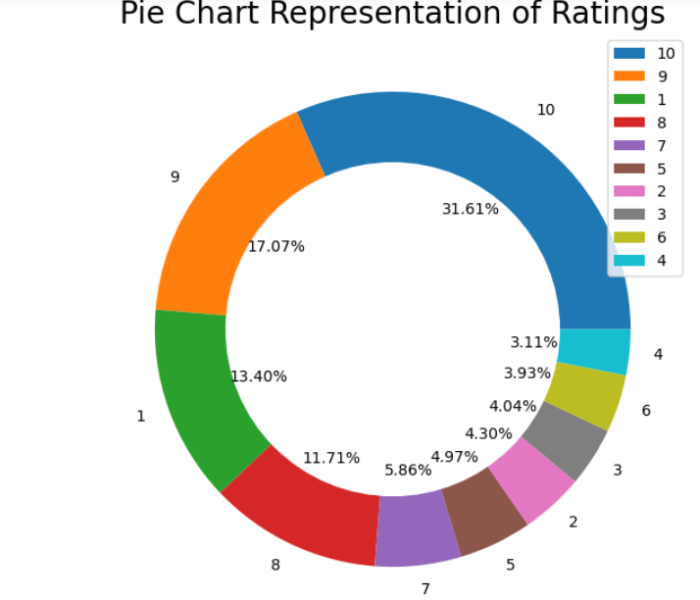
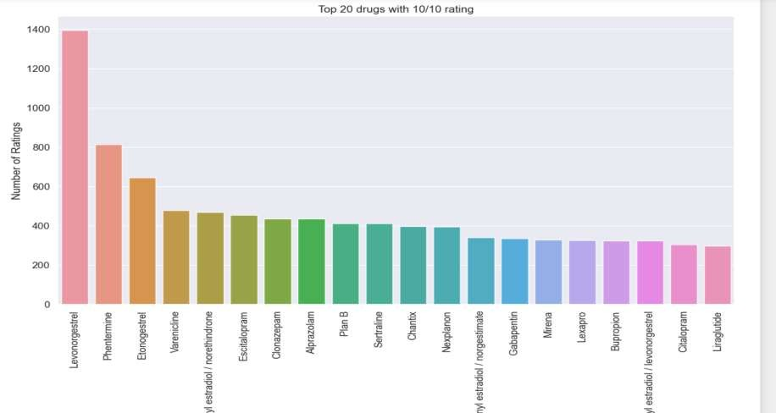
Pie Plot
Top 20 drugs with 10/10 Rating

Slide 12
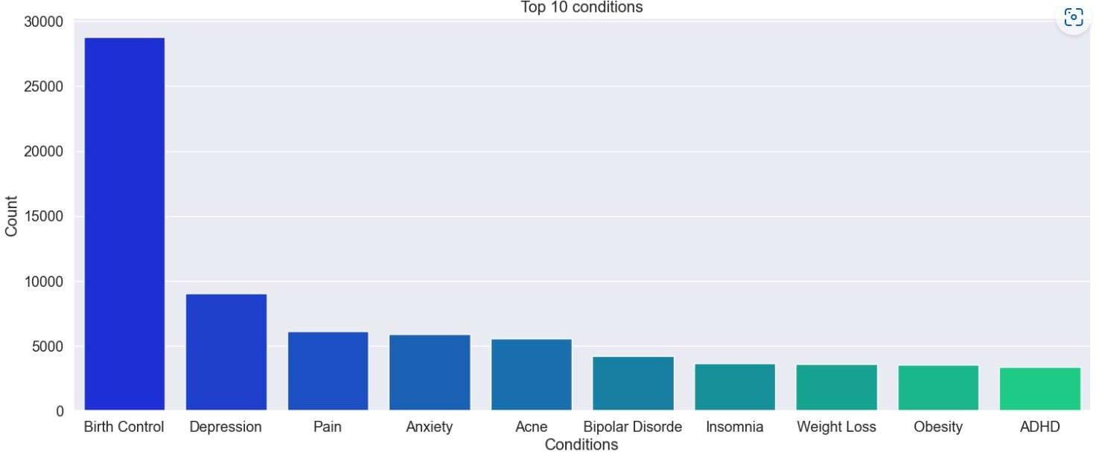
This barplot show the top 10 conditions the people are suffering.

Slide 13
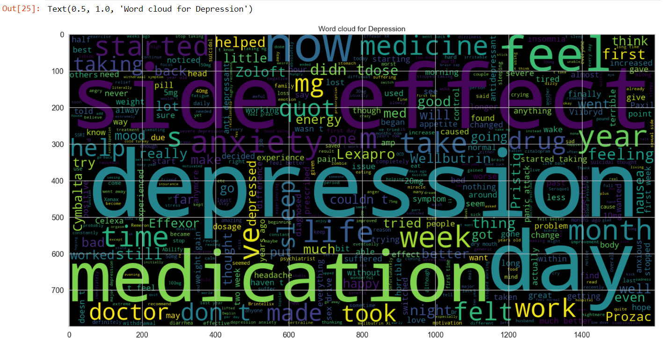
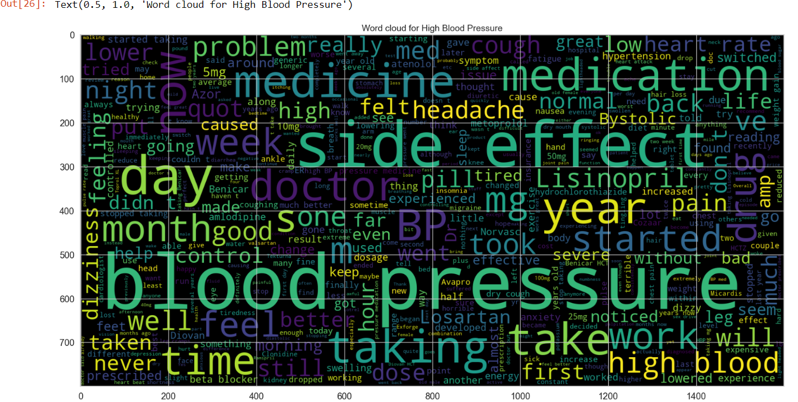
Word cloud For Conditions

Slide 14
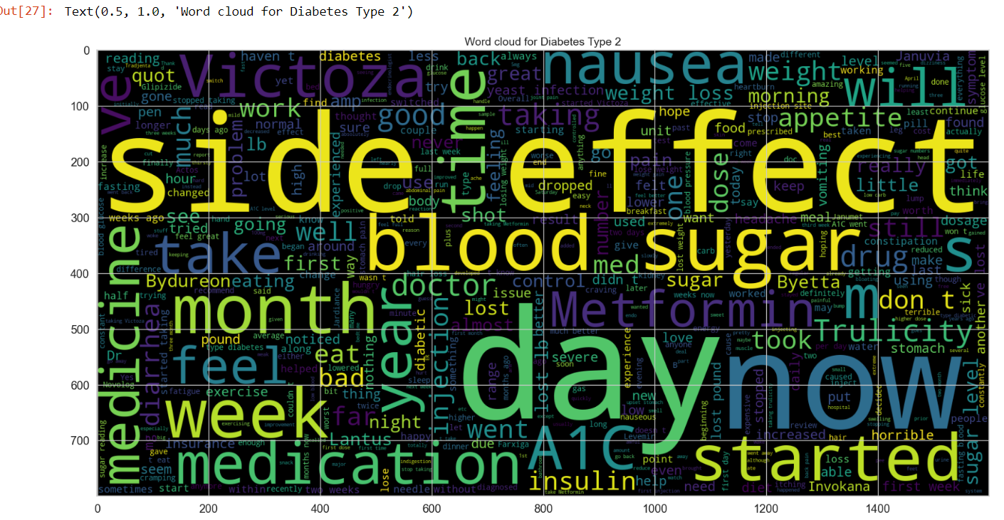
Word cloud For Diabetes Type 2

Slide 15

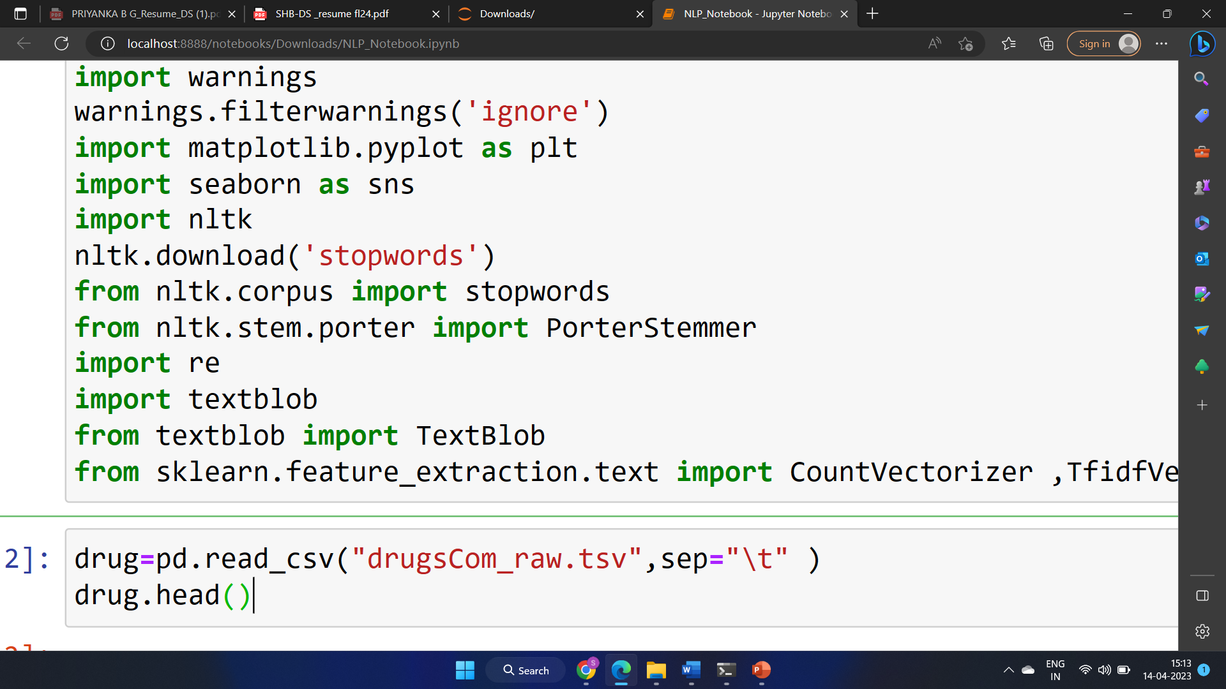
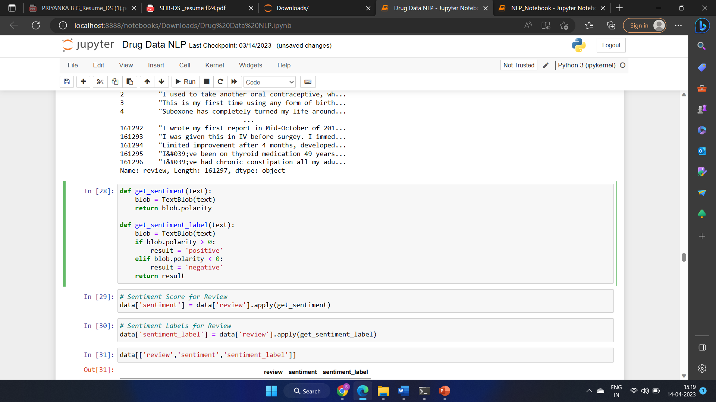
Sentimental Analysis

Slide 16
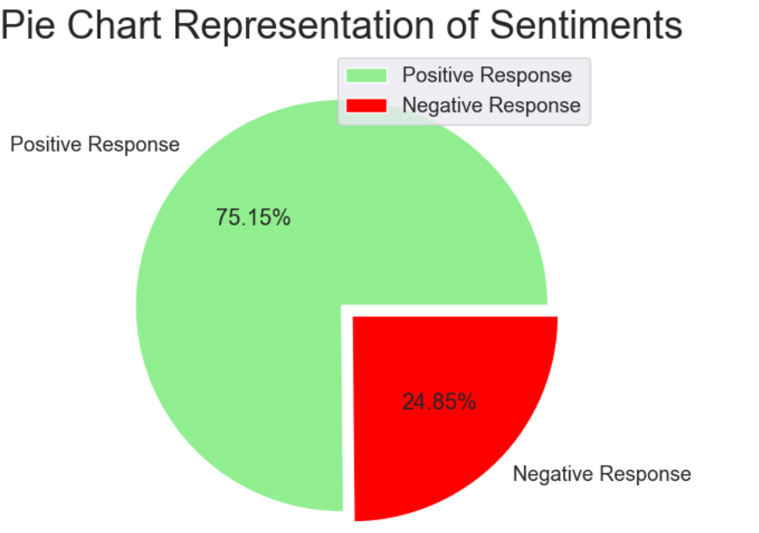
Sentimental Analysis

Slide 17
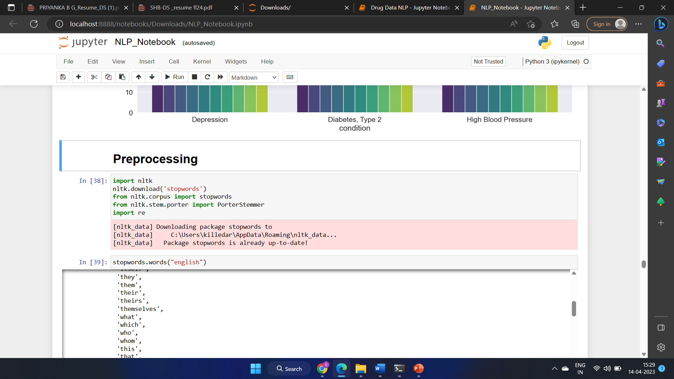
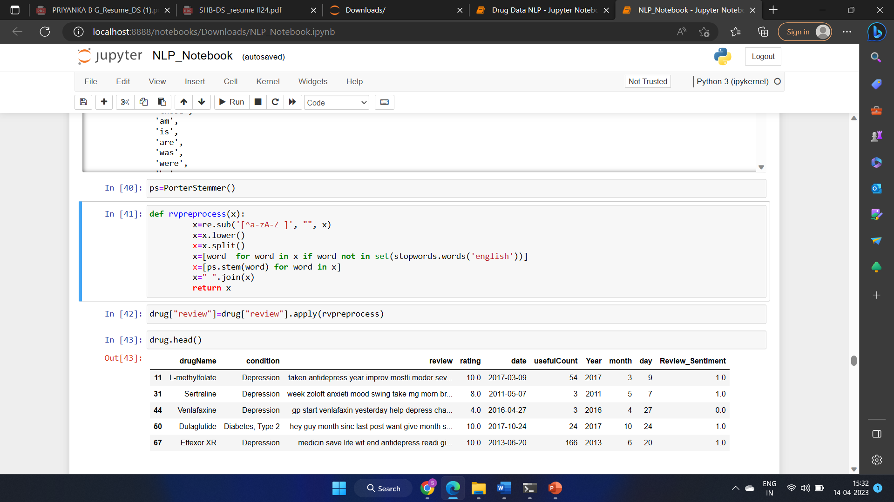
Data Pre-processing

Slide 18
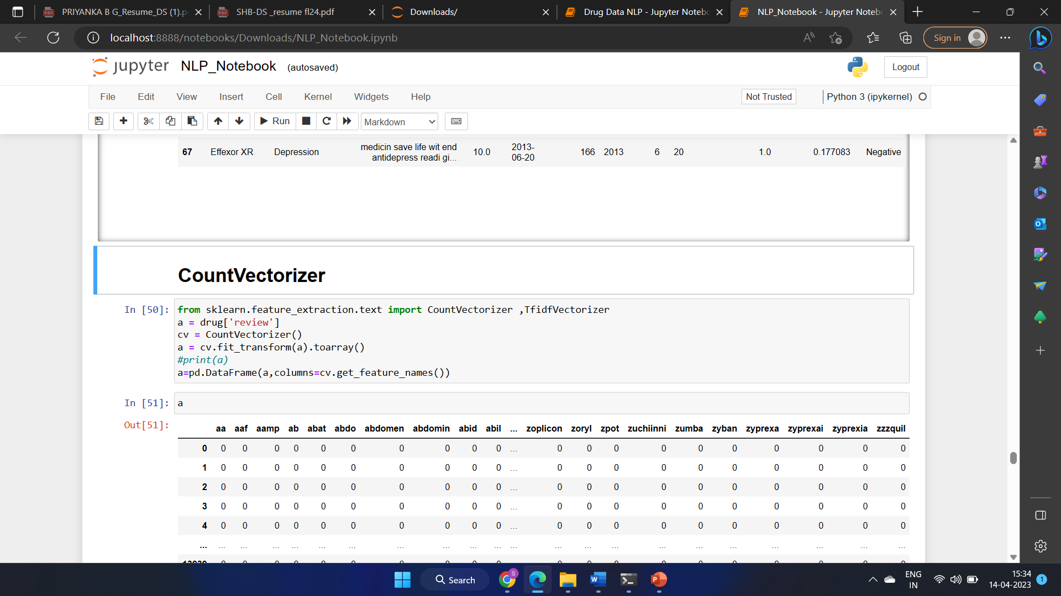
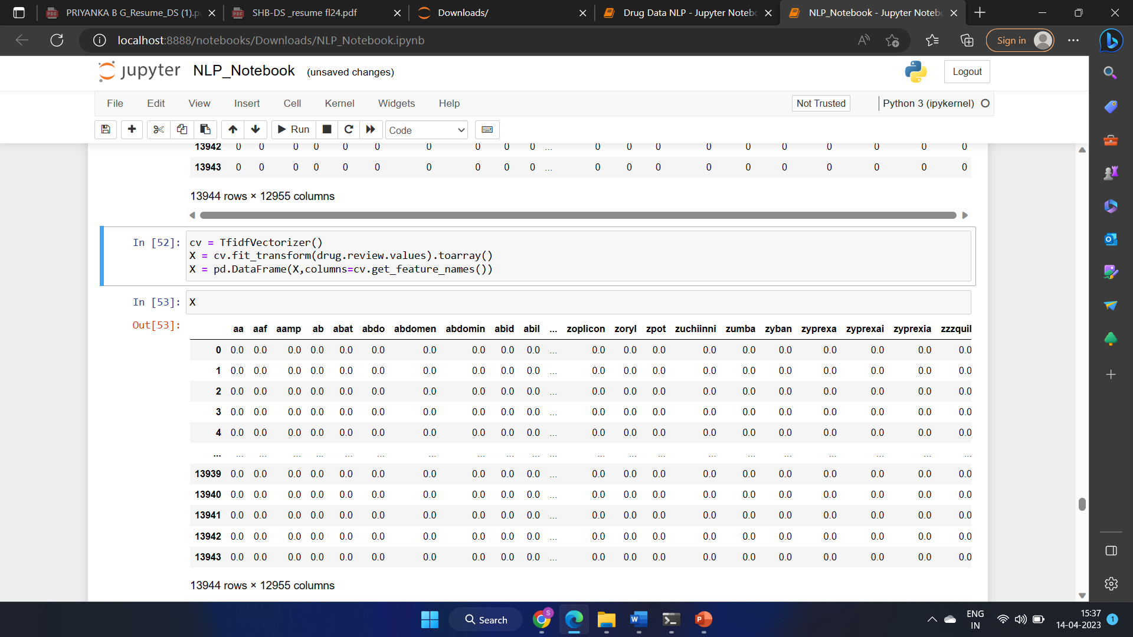
Applying Count Vectorizer & Tf-idf Vectorizer

Slide 19
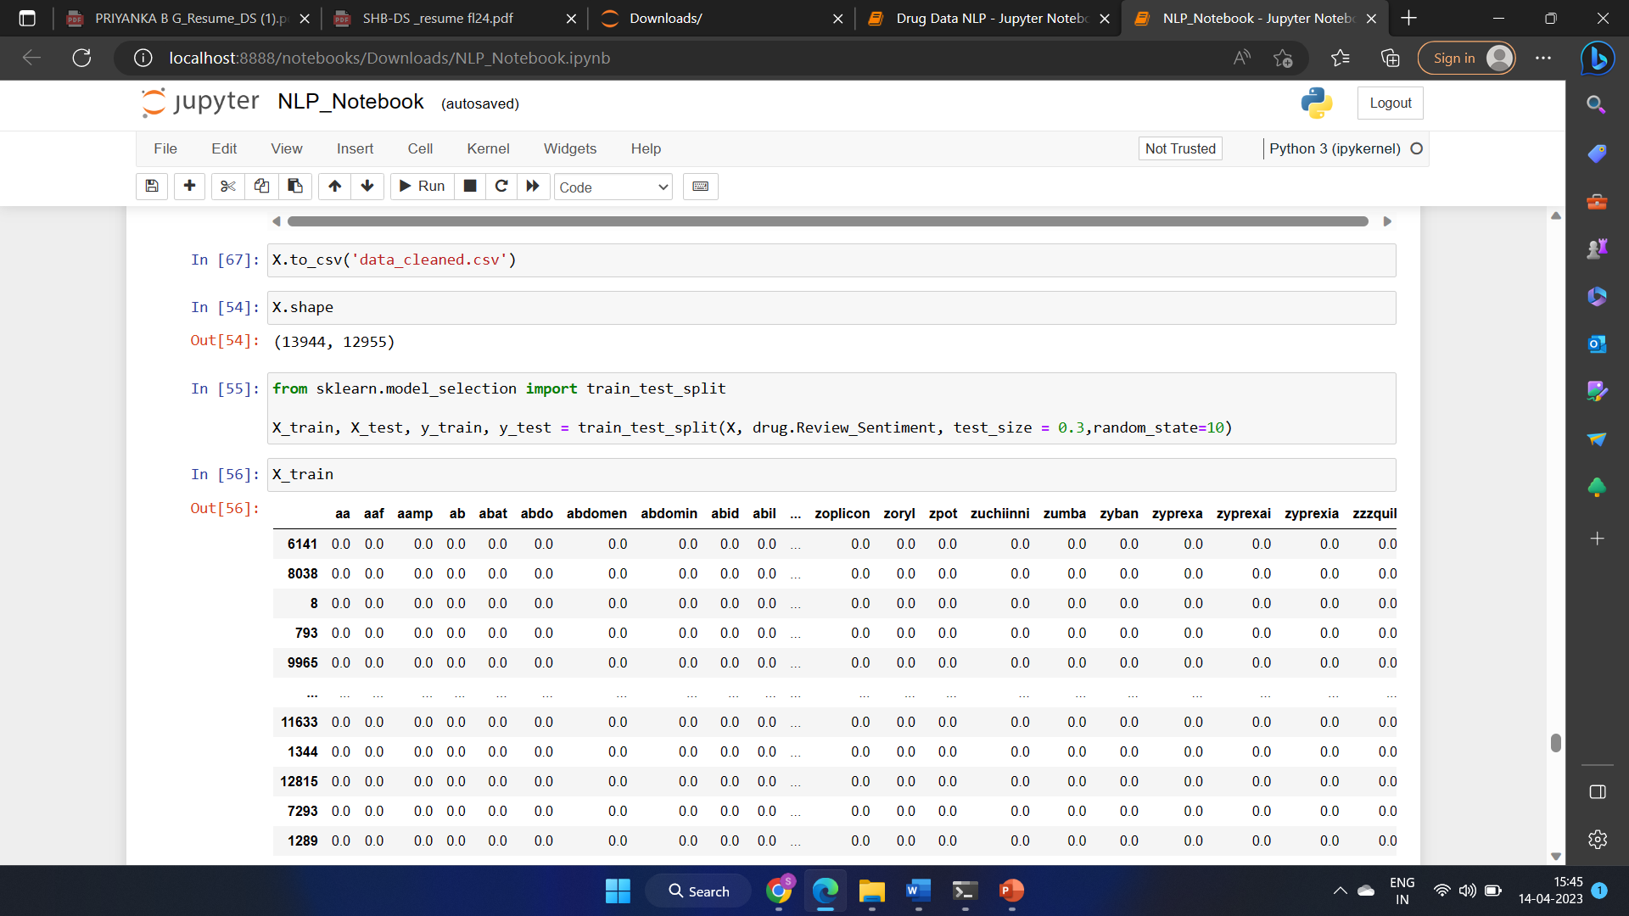
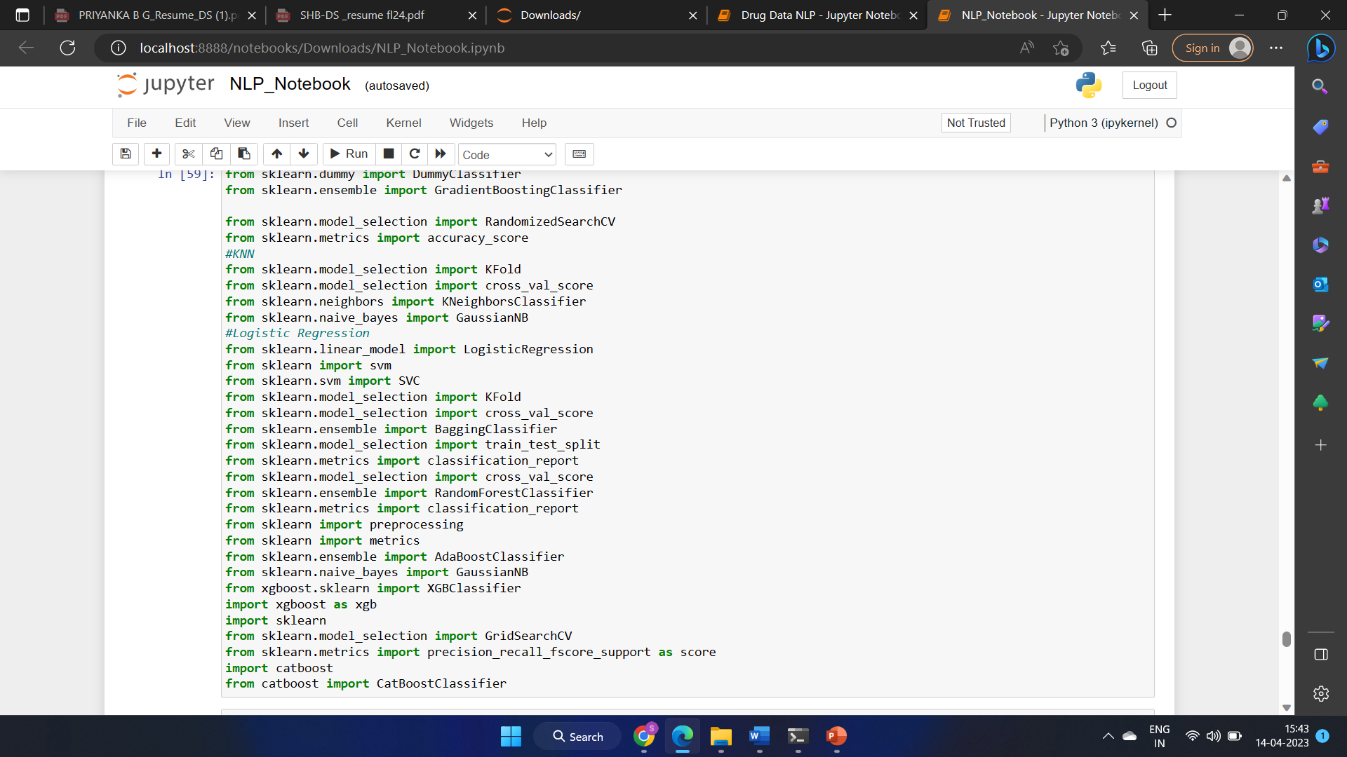
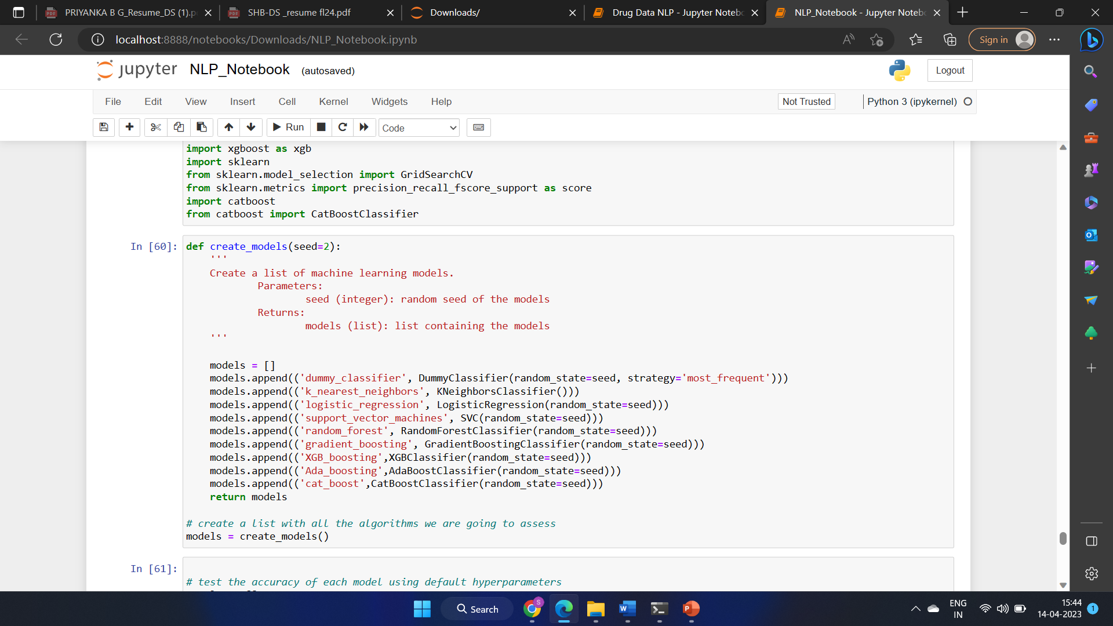
Model Building

Slide 20



Model Evaluation

Slide 21
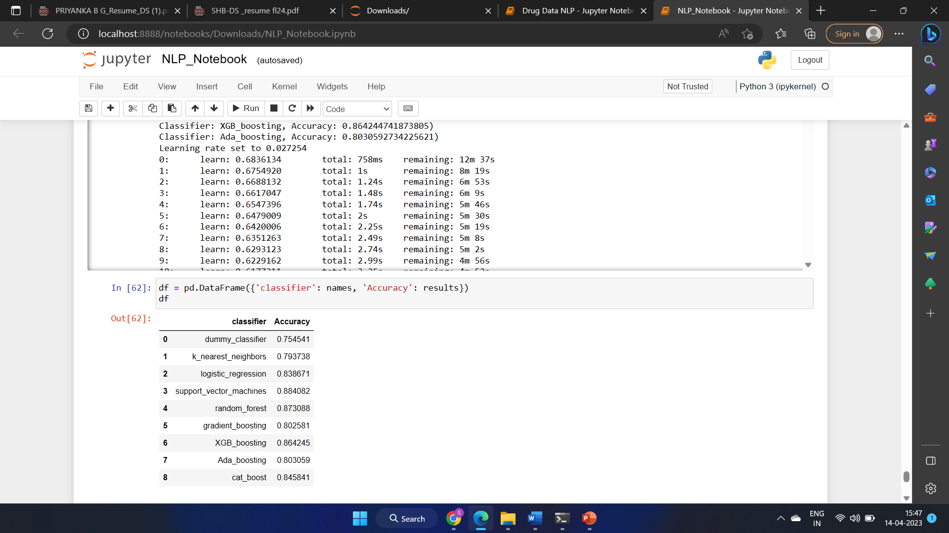
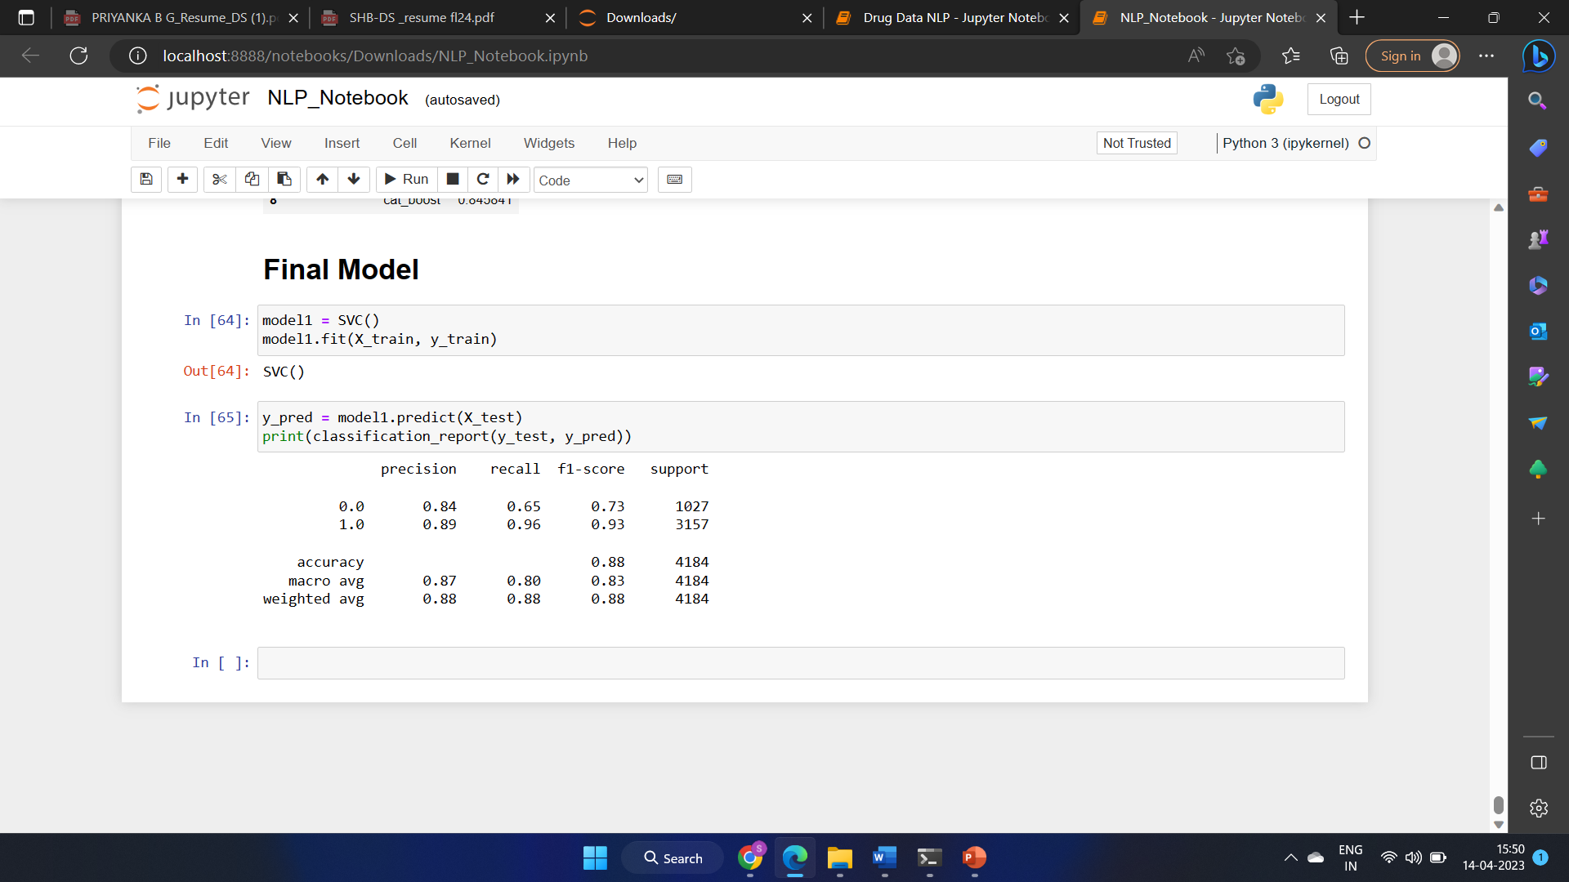
Accuracy of classifier models

Slide 22

Deployment

Slide 23
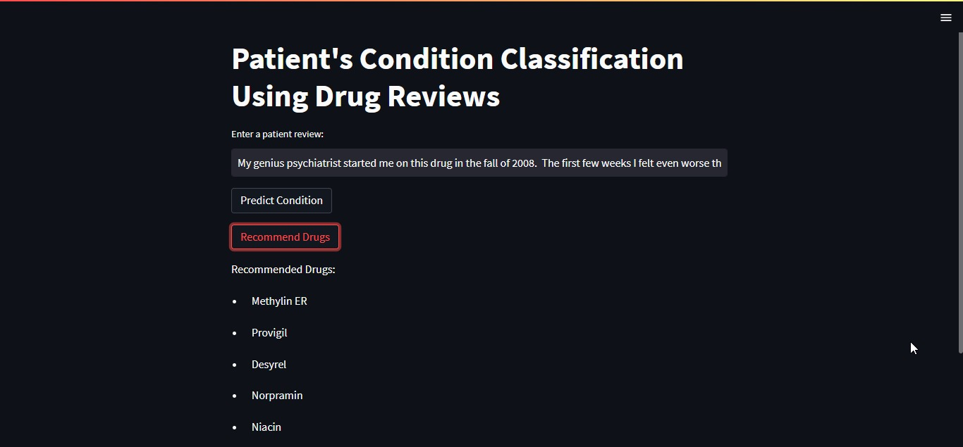
Deployment

Slide 24
Challenges faced during the project
As we are not much aware of the Medicines we have done a lot of research to find out the drugs review history.
Determining the appropriate features to incorporate, comprehending
the intricate model outputs, and avoiding overfitting the model.
We encountered some obstacles in the feature engineering stage.
Specifically, we needed to choose, modify, and remove certain features
to achieve more accurate predictions.
Identifying the ideal hyperparameters for the model.

Slide 25



